Slide 1

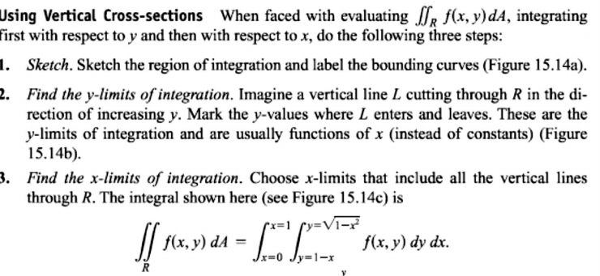
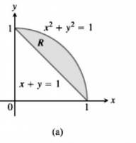
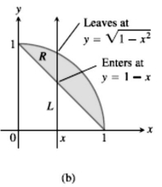
6 / Dep. Of Engineering Mechanics
th
Class: 2 AMTHMATICS / Multiple Integrals

Slide 2
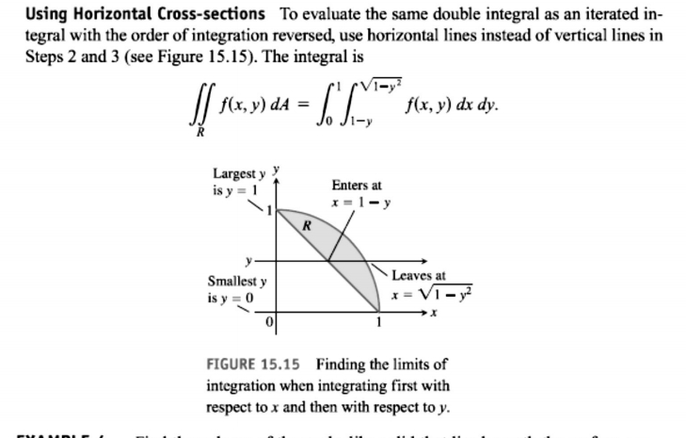

Slide 3
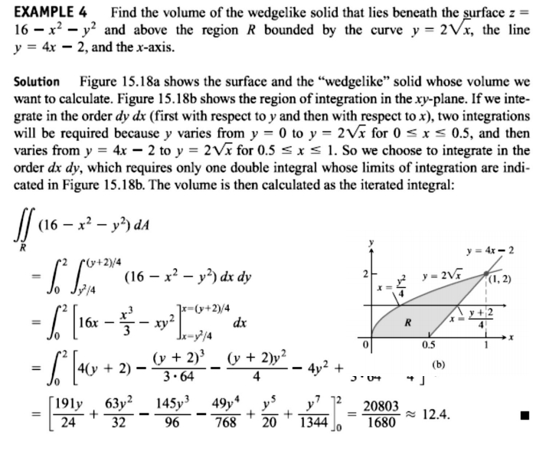
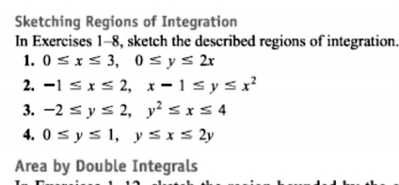
7 / Dep. Of Engineering Mechanics
th
Class: 2 AMTHMATICS / Multiple Integrals

Slide 4
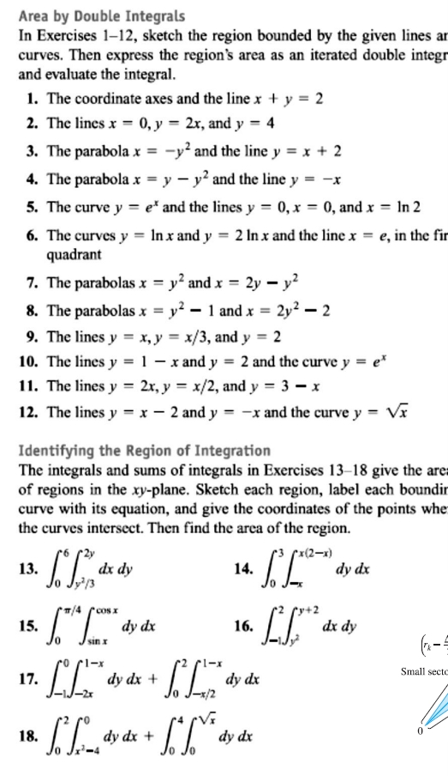
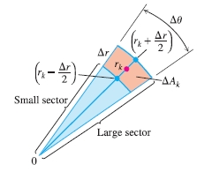
8 / Dep. Of Engineering Mechanics
th
Class: 2 AMTHMATICS / Multiple Integrals
ت ه

Slide 5
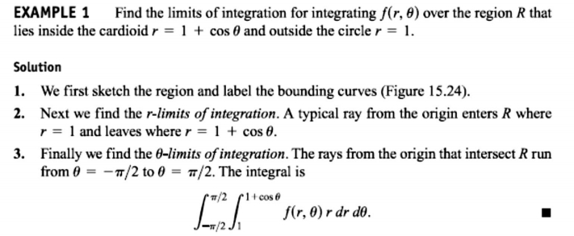
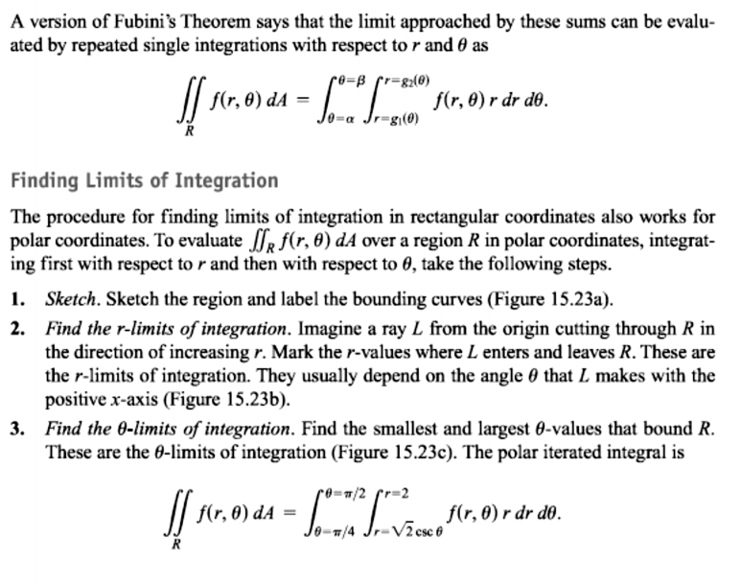
9 / Dep. Of Engineering Mechanics
th
Class: 2 AMTHMATICS / Multiple Integrals

Slide 6
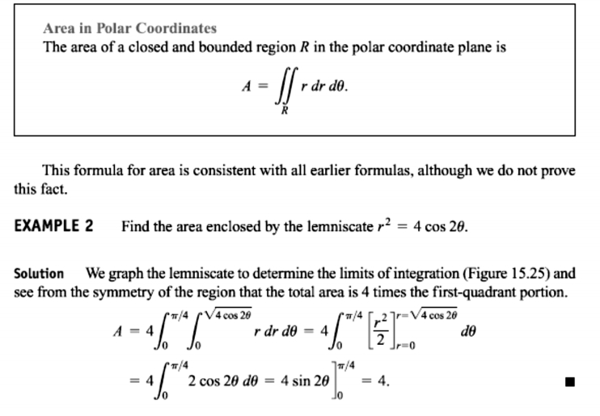
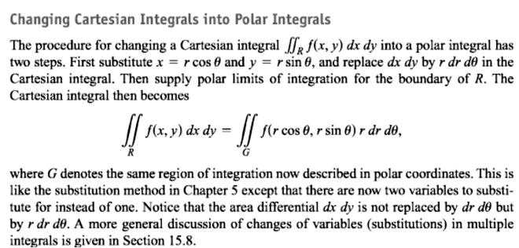
10 / Dep. Of Engineering Mechanics
th
Class: 2 AMTHMATICS / Multiple Integrals

Slide 7
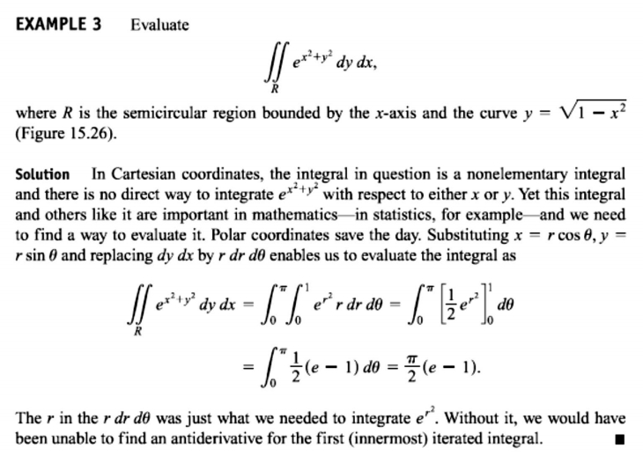
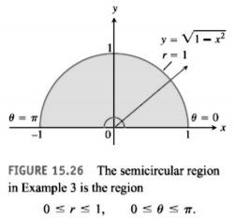
11 / Dep. Of Engineering Mechanics
th
Class: 2 AMTHMATICS / Multiple Integrals

